Slide 1

Introduction to GGplot2 Anne Segonds-Pichon, Simon Andrews v2021-09

Slide 2
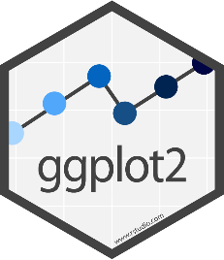
Plotting figures and graphs with ggplot
ggplot is the plotting library for tidyverse
Powerful
Flexible
Follows the same conventions as the rest of tidyverse
Data stored in tibbles
Data is arranged in 'tidy' format
Tibble is the first argument to each function

Slide 3
Code structure of a ggplot graph
Start with a call to ggplot()
Pass the tibble of data (normally via a pipe)
Say which columns you want to use via a call to aes()
Say which graphical representation (geometry) you want to use
Points, lines, barplots etc
Customise labels, colours annotations etc.

Slide 4
Geometries and Aesthetics
Geometries are types of plot
geom_point() Point geometry, (x/y plots, stripcharts etc)
geom_line() Line graphs
geom_boxplot() Box plots
geom_col() Barplots
geom_histogram() Histogram plots
Aesthetics are graphical parameters which can be adjusted in a given geometry

Slide 5
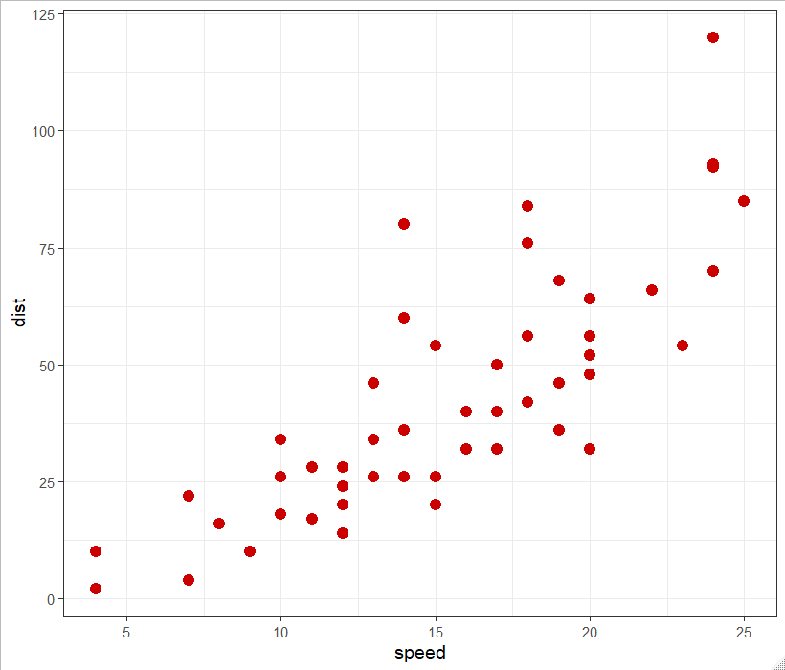
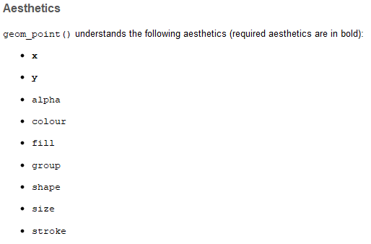
Aesthetics for geom_point()

Slide 6
How do you define aesthetics
Fixed values
Colour all points red
Make the points size 4
Encoded from your data – called an aesthetic mapping
Colour according to genotype
Size based on the number of observations
Aesthetic mappings are set using the aes() function, normally as an argument to the ggplot function
data %>% ggplot(aes(x=weight, y=height, colour=genotype))

Slide 7
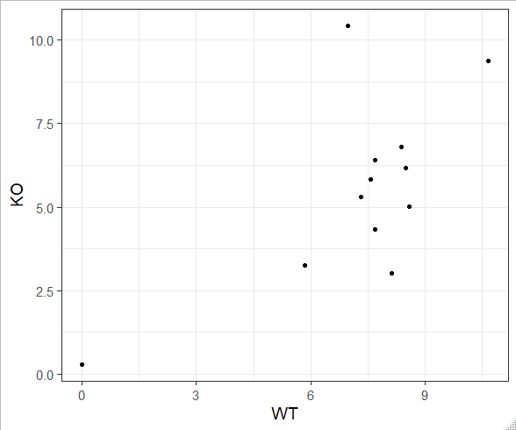
Our first plot…
ggplot( )
expression
, aes(x=WT, y=KO)
+ geom_point()
> expression
# A tibble: 12 x 4
Gene WT KO pValue
<chr> <dbl> <dbl> <dbl>
1 Mia1 5.83 3.24 0.1
2 Snrpa 8.59 5.02 0.001
3 Itpkc 8.49 6.16 0.04
4 Adck4 7.69 6.41 0.2
5 Numbl 8.37 6.81 0.1
6 Ltbp4 6.96 10.4 0.001
7 Shkbp1 7.57 5.83 0.1
8 Spnb4 10.7 9.38 0.2
9 Blvrb 7.32 5.29 0.05
10 Pgam1 0 0.285 0.5
11 Sertad3 8.13 3.02 0.0001
12 Sertad1 7.69 4.34 0.01
Identify the tibble with the data you want to plot
Decide on the geometry (plot type) you want to use
Decide which columns will modify which aesthetic
Call ggplot(aes(…..))
Add a geom_xxx function call

Slide 8
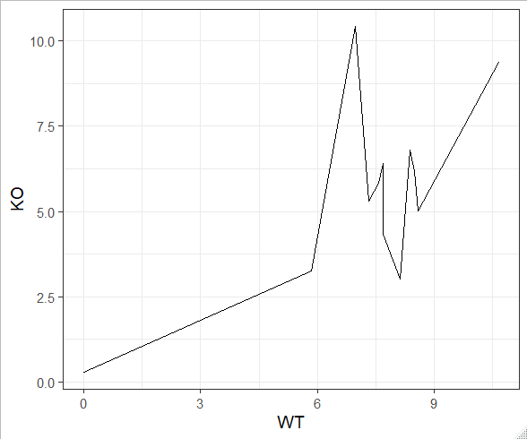
Our second plot…
ggplot( )
expression
, aes(x=WT, y=KO)
+ geom_line()
> expression
# A tibble: 12 x 4
Gene WT KO pValue
<chr> <dbl> <dbl> <dbl>
1 Mia1 5.83 3.24 0.1
2 Snrpa 8.59 5.02 0.001
3 Itpkc 8.49 6.16 0.04
4 Adck4 7.69 6.41 0.2
5 Numbl 8.37 6.81 0.1
6 Ltbp4 6.96 10.4 0.001
7 Shkbp1 7.57 5.83 0.1
8 Spnb4 10.7 9.38 0.2
9 Blvrb 7.32 5.29 0.05
10 Pgam1 0 0.285 0.5
11 Sertad3 8.13 3.02 0.0001
12 Sertad1 7.69 4.34 0.01

Slide 9
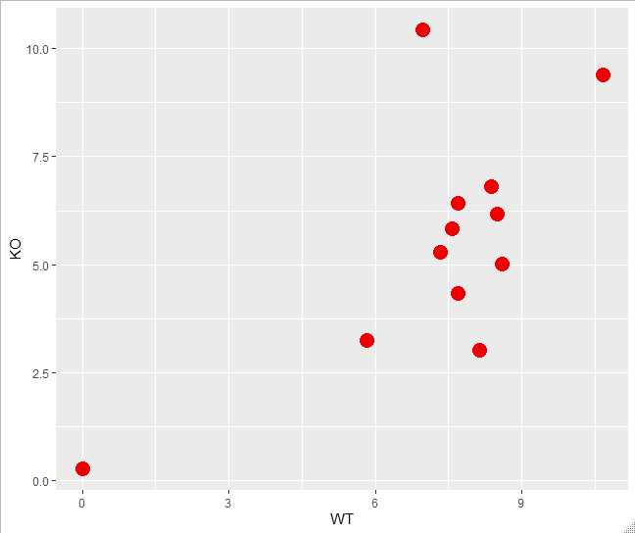
Our third plot…
expression %>%
ggplot (aes(x=WT, y=KO)) +
geom_point(colour="red2", size=5)

Slide 10
Exercise 1

Slide 11
More Geometries

Slide 12
Other Geometries
Barplots
geom_bar
geom_col
Stripcharts
geom_jitter
Distribution Summaries
geom_histogram
geom_density
geom_violin
geom_boxplot

Slide 13
Drawing a barplot (geom_col() or geom_bar())
Two different functions – depends on the nature of the data
If your data has values which represents the height of the bars use geom_col
If your data has individual values and you want the plot to either count them or calculate a quantitative summary (usually the mean) then use geom_bar
Many geometries are “summarising geometries”. They calculate one or more aesthetics for you.

Slide 14
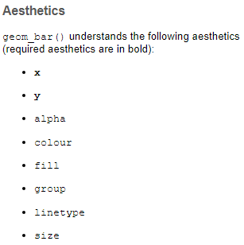
Drawing a bar height barplot (geom_col())
Plot the expression values for the WT samples for all genes
What is your X?
What is your Y?
> expression
# A tibble: 12 x 4
Gene WT KO pValue
<chr> <dbl> <dbl> <dbl>
1 Mia1 5.83 3.24 0.1
2 Snrpa 8.59 5.02 0.001

Slide 15
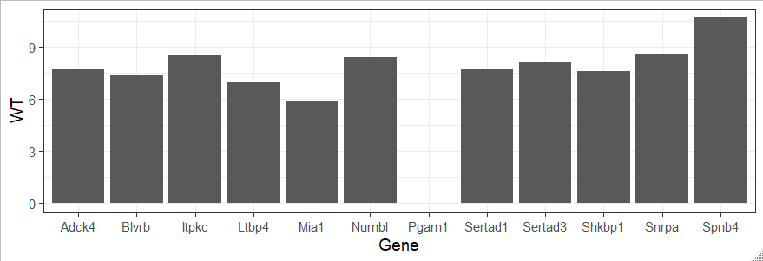
A bar height barplot
> expression
# A tibble: 12 x 4
Gene WT KO pValue
<chr> <dbl> <dbl> <dbl>
1 Mia1 5.83 3.24 0.1
2 Snrpa 8.59 5.02 0.001
expression %>%
ggplot(aes(x=Gene, y=WT)) +
geom_col()

Slide 16
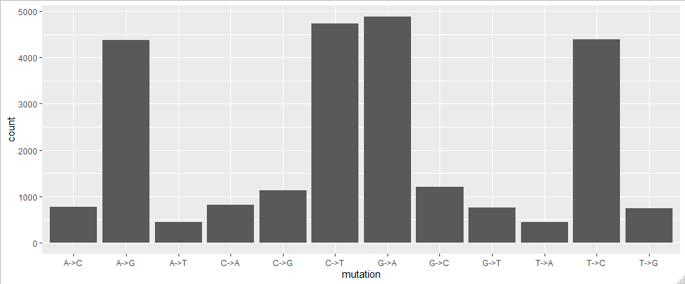
A count summary barplot (geom_bar)
mutation.plotting.data %>%
ggplot(aes(x=mutation)) +
geom_bar()
> mutation.plotting.data
# A tibble: 24,686 x 9
CHR POS dbSNP mutation
<chr> <dbl> <chr> <chr>
1 1 69270 . A->G
2 1 69511 rs75062661 A->G
3 1 69761 . A->T
4 1 69897 rs75758884 T->C
5 1 877831 rs6672356 T->C
6 1 881627 rs2272757 G->A

Slide 17
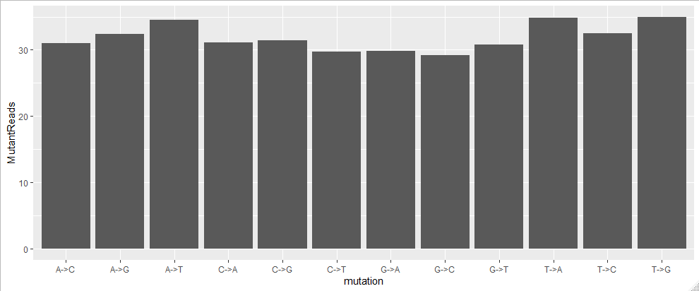
A mean summary barplot (geom_bar)
mutation.plotting.data %>%
ggplot(aes(x=mutation, y=MutantReads)) +
geom_bar(stat="summary", fun=mean)
> mutation.plotting.data
# A tibble: 24,686 x 9
CHR POS mutation MutantReads
<chr> <dbl> <chr> <dbl>
1 1 69270 A->G 3
2 1 69511 A->G 24
3 1 69761 A->T 8
4 1 69897 T->C 3
5 1 877831 T->C 10
6 1 881627 G->A 52
7 1 887801 A->G 47
8 1 888639 T->C 23
9 1 888659 T->C 17
10 1 889158 G->C 25

Slide 18
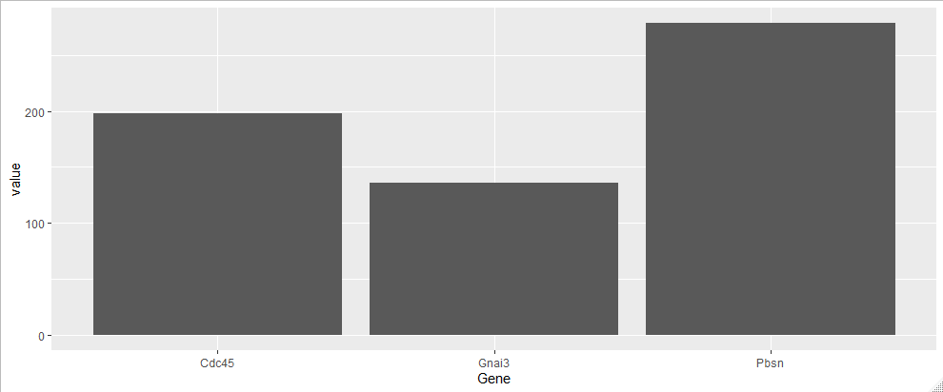
Stacked and Grouped Barplots
bar.group %>%
ggplot(aes(x=Gene, y=value)) +
geom_col()
> bar.group
# A tibble: 12 x 3
Gene genotype value
<chr> <chr> <dbl>
1 Gnai3 WT 9.39
2 Pbsn WT 91.7
3 Cdc45 WT 69.2
4 Gnai3 WT 10.9
5 Pbsn WT 59.6
6 Cdc45 WT 36.1
7 Gnai3 KO 33.5
8 Pbsn KO 45.3
9 Cdc45 KO 54.4
10 Gnai3 KO 81.9
11 Pbsn KO 82.3
12 Cdc45 KO 38.1
Sum of values

Slide 19
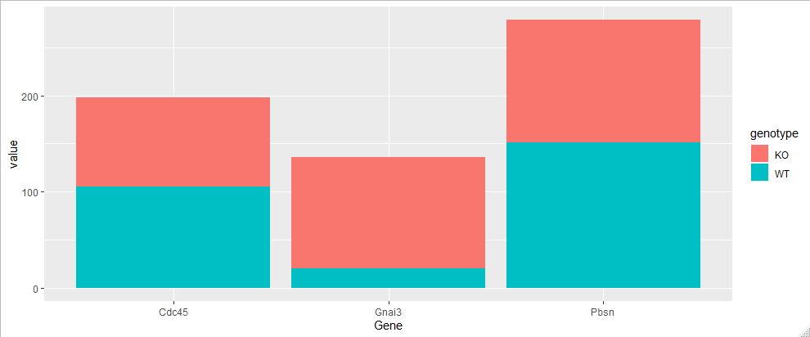
Stacked and Grouped Barplots
bar.group %>%
ggplot(aes(x=Gene, y=value, fill=genotype)) +
geom_col()
> bar.group
# A tibble: 12 x 3
Gene genotype value
<chr> <chr> <dbl>
1 Gnai3 WT 9.39
2 Pbsn WT 91.7
3 Cdc45 WT 69.2
4 Gnai3 WT 10.9
5 Pbsn WT 59.6
6 Cdc45 WT 36.1
7 Gnai3 KO 33.5
8 Pbsn KO 45.3
9 Cdc45 KO 54.4
10 Gnai3 KO 81.9
11 Pbsn KO 82.3
12 Cdc45 KO 38.1
Stacked Sums

Slide 20
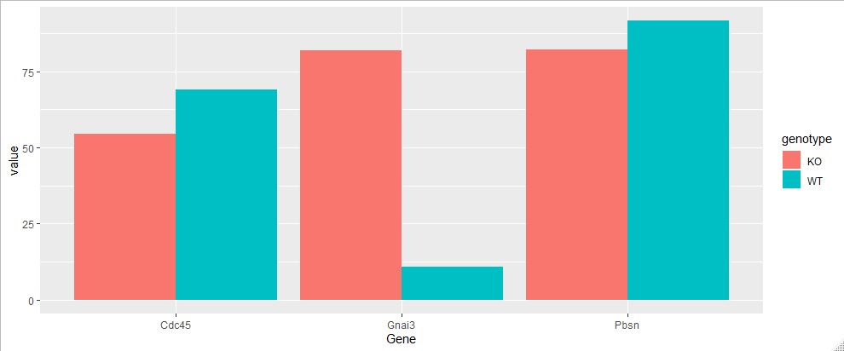
Stacked and Grouped Barplots
bar.group %>%
ggplot(aes(x=Gene, y=value, fill=genotype)) +
geom_col(position="dodge")
> bar.group
# A tibble: 12 x 3
Gene genotype value
<chr> <chr> <dbl>
1 Gnai3 WT 9.39
2 Pbsn WT 91.7
3 Cdc45 WT 69.2
4 Gnai3 WT 10.9
5 Pbsn WT 59.6
6 Cdc45 WT 36.1
7 Gnai3 KO 33.5
8 Pbsn KO 45.3
9 Cdc45 KO 54.4
10 Gnai3 KO 81.9
11 Pbsn KO 82.3
12 Cdc45 KO 38.1
Individual values

Slide 21
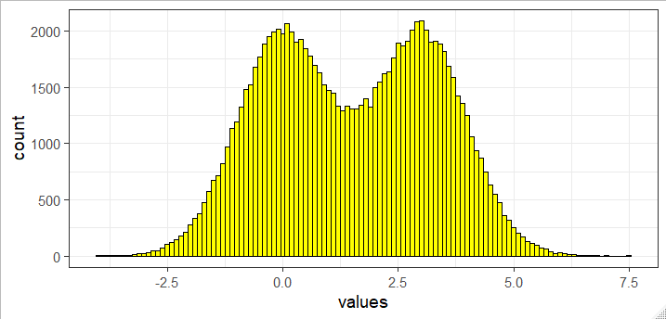
Plotting distributions - histograms
> many.values
# A tibble: 100,000 x 2
values genotype
<dbl> <chr>
1 1.90 KO
2 2.39 WT
3 4.32 KO
4 2.94 KO
5 0.728 WT
6 -0.280 WT
7 0.337 WT
8 -1.31 WT
9 1.55 WT
10 1.86 KO
many.values %>%
ggplot(aes(x=values)) +
geom_histogram(binwidth = 0.1, fill="yellow", colour="black")

Slide 22
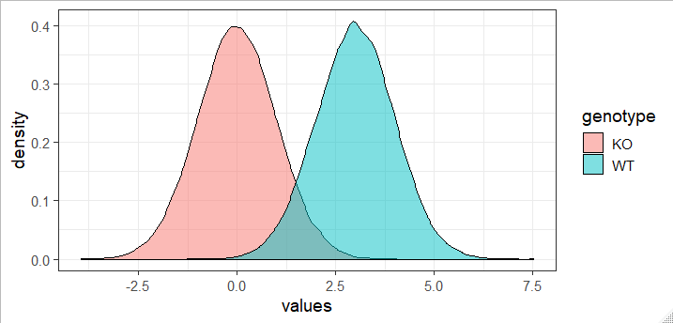
Plotting distributions - density
> many.values
# A tibble: 100,000 x 2
values genotype
<dbl> <chr>
1 1.90 KO
2 2.39 WT
3 4.32 KO
4 2.94 KO
5 0.728 WT
6 -0.280 WT
7 0.337 WT
8 -1.31 WT
9 1.55 WT
10 1.86 KO
many.values %>%
ggplot(aes(x=values, fill=genotype)) +
geom_density(colour="black", alpha=0.5)

Slide 23
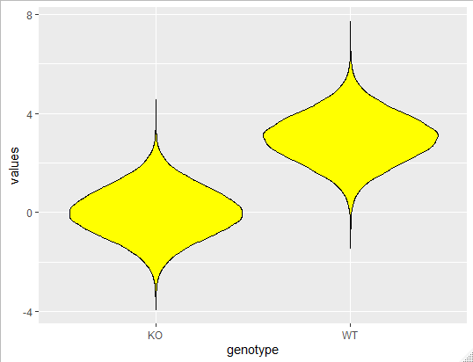
Plotting distributions – violin plots
> many.values
# A tibble: 100,000 x 2
values genotype
<dbl> <chr>
1 1.90 KO
2 2.39 WT
3 4.32 KO
4 2.94 KO
5 0.728 WT
6 -0.280 WT
7 0.337 WT
8 -1.31 WT
9 1.55 WT
10 1.86 KO
many.values %>%
ggplot(aes(x=genotype, y=values)) +
geom_violin(colour="black", fill="yellow")

Slide 24
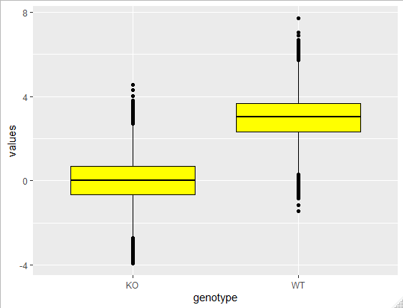
Plotting distributions – boxplots
> many.values
# A tibble: 100,000 x 2
values genotype
<dbl> <chr>
1 1.90 KO
2 2.39 WT
3 4.32 KO
4 2.94 KO
5 0.728 WT
6 -0.280 WT
7 0.337 WT
8 -1.31 WT
9 1.55 WT
10 1.86 KO
many.values %>%
ggplot(aes(x=genotype, y=values)) +
geom_boxplot(colour="black", fill="yellow")

Slide 25
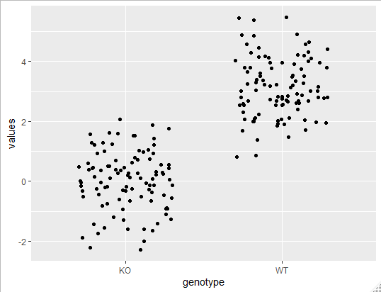
Plotting distributions – stripcharts
> many.values
# A tibble: 100,000 x 2
values genotype
<dbl> <chr>
1 1.90 KO
2 2.39 WT
3 4.32 KO
4 2.94 KO
5 0.728 WT
6 -0.280 WT
7 0.337 WT
8 -1.31 WT
9 1.55 WT
10 1.86 KO
many.values %>%
group_by(genotype) %>%
sample_n(100) %>%
ggplot(aes(x=genotype, y=values)) +
geom_jitter(height=0, width = 0.3)

Slide 26
Exercise 2

Slide 27
Annotation, Scaling and Colours

Slide 28
Titles and axis labels
Can add calls to functions to set them individually
ggtitle("Main title")
xlab("X axis")
ylab("Y axis")
Can set them all together with labs()
title="Main title"
x="X axis"
y="Y axis"

Slide 29
Changing scaling
Alter the data before plotting
mutate(value=log(value))
Alter the data whilst plotting
ggplot(aes(x=log(value)))
Alter the scale of the plot
Add an option to adjust the scaling of the axis

Slide 30
Axis scaling options
Transforming scales
scale_x_log10()
scale_x_sqrt()
scale_x_reverse()
Equivalent _y_ versions also exist
Switching axes
coord_flip()
Adjusting ranges
scale_x_continuous()
limits=c(-5,5)
breaks=seq(from=-5,by=2,to=5)
minor_breaks
labels
coord_cartesian()
xlim=c(-5,5)
ylim=c(10,20)

Slide 31
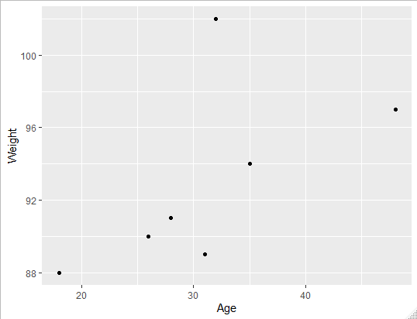
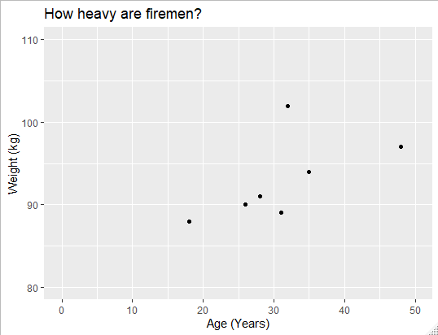
Annotation and scaling example
trumpton %>%
ggplot(aes(x=Age, y=Weight))+
geom_point() +
xlab("Age (Years)")+
ylab("Weight (kg)")+
ggtitle("How heavy are firemen?")+
coord_cartesian(
xlim=c(0,50),
ylim=c(80,110)
)

Slide 32
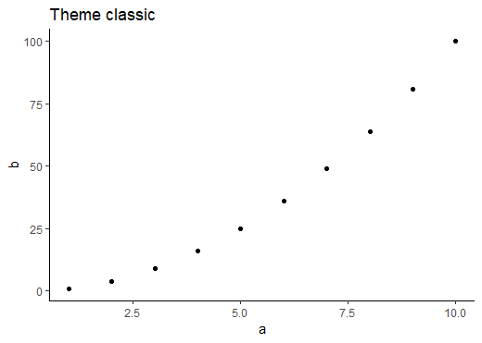
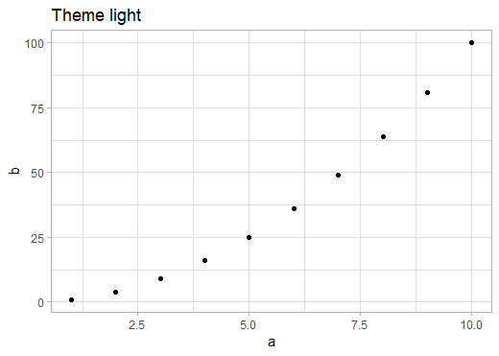
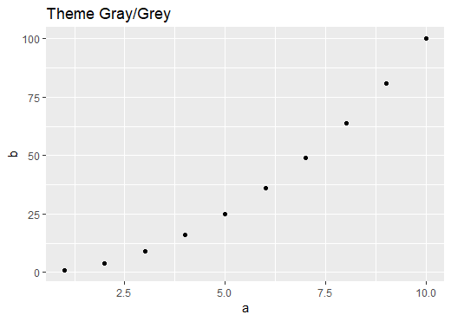
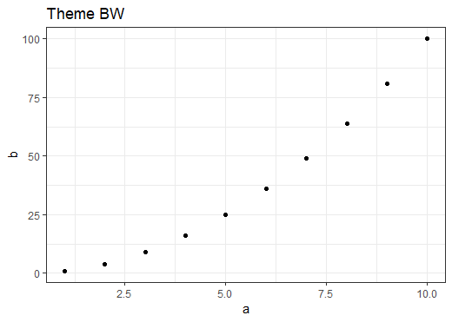
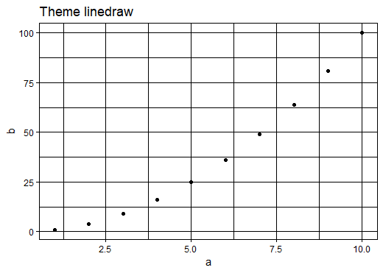
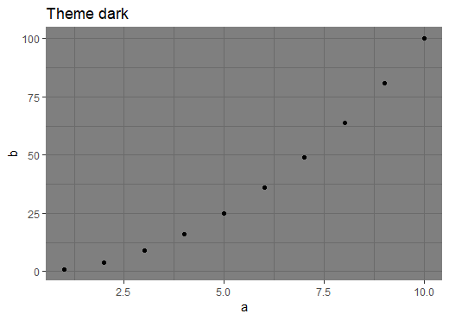
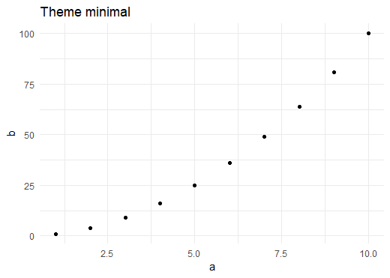
ggPlot Themes
theme_grey()
theme_bw()
theme_dark()
theme_light()
theme_minimal()
theme_classic()
theme_linedraw()

Slide 33
Setting and Customising themes
Globally
theme_set(theme_bw(base_size=14))
In a single plot
+theme_dark()

Slide 34
Customising themes
theme_update(plot.title = element_text(hjust = 0.5))
plot + theme(plot.title = element_text(hjust = 0.5))
theme(line, rect, text, title, aspect.ratio, axis.title, axis.title.x, axis.title.x.top, axis.title.x.bottom, axis.title.y, axis.title.y.left,axis.title.y.right, axis.text, axis.text.x, axis.text.x.top, axis.text.x.bottom, axis.text.y, axis.text.y.left, axis.text.y.right, axis.ticks, axis.ticks.x, axis.ticks.x.top, axis.ticks.x.bottom, axis.ticks.y, axis.ticks.y.left, axis.ticks.y.right, axis.ticks.length, axis.line, axis.line.x, axis.line.x.top, axis.line.x.bottom, axis.line.y, axis.line.y.left, axis.line.y.right, legend.background, legend.margin, legend.spacing, legend.spacing.x, legend.spacing.y, legend.key, legend.key.size, legend.key.height, legend.key.width, legend.text, legend.text.align, legend.title, legend.title.align, legend.position, legend.direction, legend.justification, legend.box, legend.box.just, legend.box.margin, legend.box.background, legend.box.spacing, panel.background, panel.border, panel.spacing, panel.spacing.x, panel.spacing.y, panel.grid, panel.grid.major, panel.grid.minor, panel.grid.major.x, panel.grid.major.y, panel.grid.minor.x, panel.grid.minor.y, panel.ontop, plot.background, plot.title, plot.subtitle, plot.caption, plot.tag, plot.tag.position, plot.margin, strip.background, strip.background.x, strip.background.y, strip.placement, strip.text, strip.text.x, strip.text.y, strip.switch.pad.grid, strip.switch.pad.wrap)
https://ggplot2.tidyverse.org/reference/theme.html

Slide 35
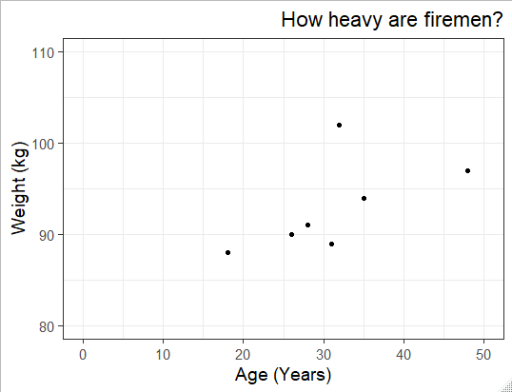
Theme setting example
theme_set(theme_bw(base_size = 14))
theme_update(plot.title = element_text(hjust=1))
OR
my.plot +
theme_bw(base_size = 14) +
theme(plot.title = element_text(hjust=1))

Slide 36
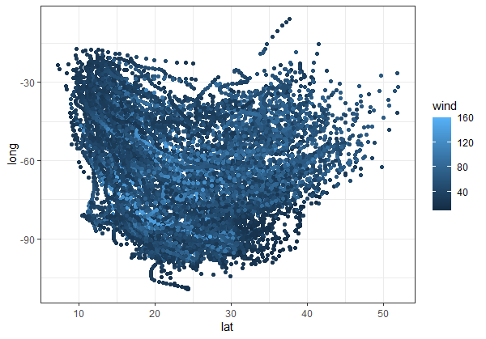
Changing Quantitative Colours
storms %>%
ggplot(aes(x=lat, y=long, colour=wind)) +
geom_point()

Slide 37
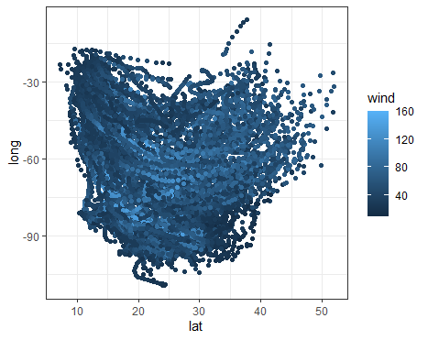
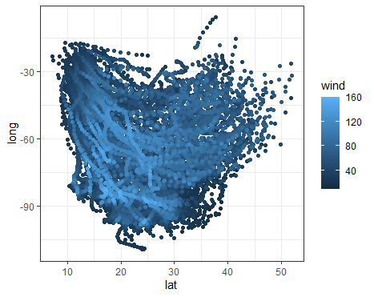
Changing Plotting Order
storms %>%
ggplot(aes(x=lat,y=long,colour=wind))+
geom_point()
storms %>%
arrange(wind) %>%
ggplot(aes(x=lat,y=long,colour=wind))+
geom_point()

Slide 38
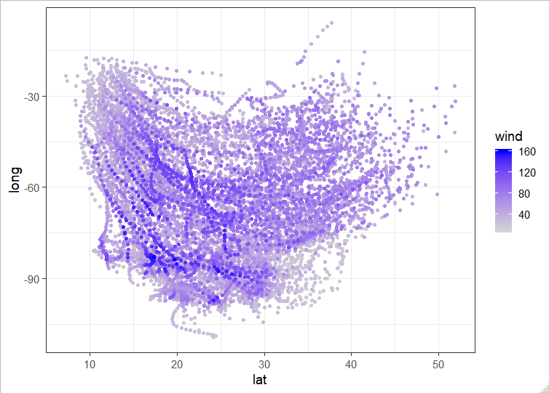
Changing Quantitative Colours
storms %>%
arrange(wind) %>%
ggplot(aes(x=lat, y=long, colour=wind))+
geom_point() +
scale_colour_gradient(low="lightgrey", high="blue")

Slide 39
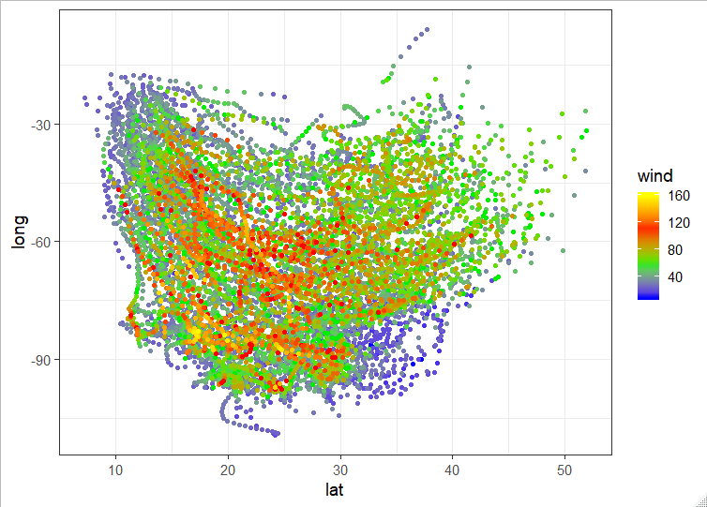
Changing Quantitative Colours
storms %>%
arrange(wind) %>%
ggplot(aes(x=lat, y=long, colour=wind))+
geom_point() +
scale_colour_gradientn(colours=c("blue","green2","red","yellow"))

Slide 40
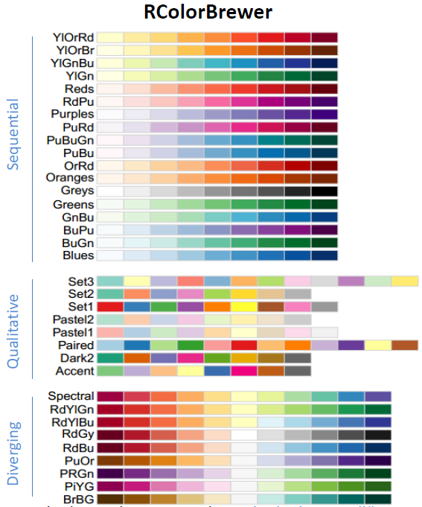
ColorBrewer Scales
Quantitative
scale_colour_distiller
Categorical
scale_colour_brewer

Slide 41
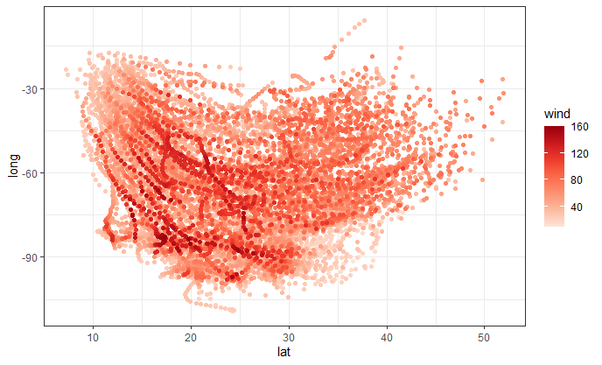
Changing Quantitative Colours
storms %>%
arrange(wind) %>%
ggplot(aes(x=lat, y=long, color=wind))+
geom_point() +
scale_color_distiller(palette="Reds", direction = 1)

Slide 42
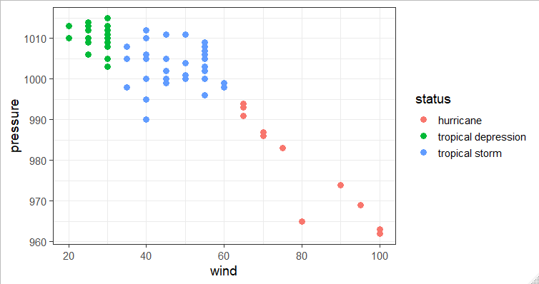
Changing Categorical Colours
storms %>%
filter(year==1983) %>%
ggplot(aes(x=wind, y=pressure, colour=status)) +
geom_point(size=3)

Slide 43
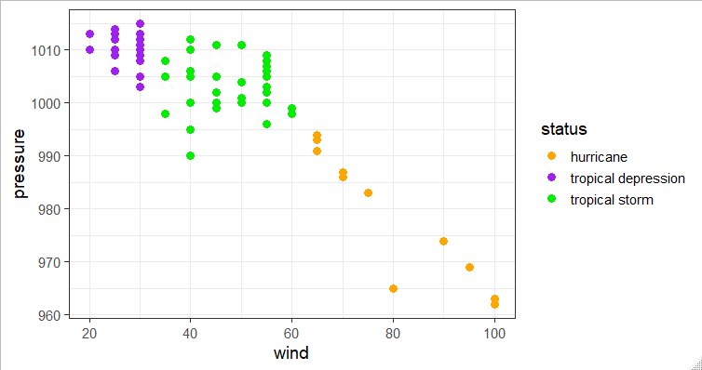
Changing Categorical Colours
storms %>%
filter(year==1983) %>%
ggplot(aes(x=wind,y=pressure, colour=status)) +
geom_point(size=3) +
scale_colour_manual(values = c("orange","purple","green2"))

Slide 44
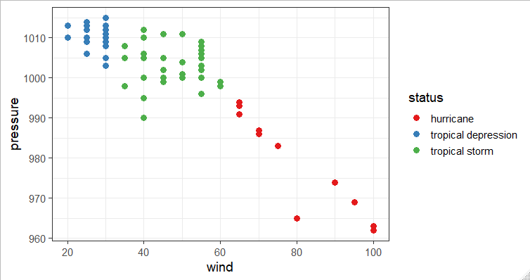
Changing Categorical Colours
storms %>%
filter(year==1983) %>%
ggplot(aes(x=wind,y=pressure, colour=status)) +
geom_point(size=3) +
scale_colour_brewer(palette="Set1")

Slide 45
Categorical Colour Ordering
# A tibble: 10,010 x 6
lat long status category wind pressure
<dbl> <dbl> <chr> <ord> <int> <int>
1 27.5 -79 tropical depression -1 25 1013
2 28.5 -79 tropical depression -1 25 1013
3 29.5 -79 tropical depression -1 25 1013
4 30.5 -79 tropical depression -1 25 1013
5 31.5 -78.8 tropical depression -1 25 1012
6 32.4 -78.7 tropical depression -1 25 1012
7 33.3 -78 tropical depression -1 25 1011
8 34 -77 tropical depression -1 30 1006
9 34.4 -75.8 tropical storm 0 35 1004
10 34 -74.8 tropical storm 0 40 1002
# ... with 10,000 more rows
Status is a character vector – ordering is alphabetical

Slide 46
Factors
Similar to text (character) vectors, but with some differences
They have controlled values – you can limit which values can be added
The values which can go in are tracked separately to the data
The values which can go in have an explicit order
GGplot respects the ordering of factors, so converting to factors is the simplest way to re-order a plot

Slide 47
Converting character vectors to factors
> chr.names
[1] "simon" "anne" "laura" "felix" "simon" "anne" "laura"
[8] "felix" "simon" "anne" "laura" "felix" "simon" "anne"
[15] "laura" "felix" "simon" "anne" "laura" "felix"
> factor(chr.names)
[1] simon anne laura felix simon anne laura felix simon
[10] anne laura felix simon anne laura felix simon anne
[19] laura felix
Levels: anne felix laura simon
> factor(chr.names, levels=c("simon","anne","laura","felix"))
[1] simon anne laura felix simon anne laura felix simon
[10] anne laura felix simon anne laura felix simon anne
[19] laura felix
Levels: simon anne laura felix

Slide 48
Categorical Colour Ordering
Use factors for explicit ordering
storms %>%
mutate(
status=factor(
status,
levels=c("tropical depression","tropical storm","hurricane")
)
)
# A tibble: 10,010 x 6
lat long status category wind pressure
<dbl> <dbl> <fct> <ord> <int> <int>
1 27.5 -79 tropical depression -1 25 1013
2 28.5 -79 tropical depression -1 25 1013
3 29.5 -79 tropical depression -1 25 1013
4 30.5 -79 tropical depression -1 25 1013

Slide 49
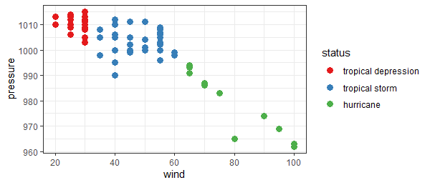
Categorical Colour Ordering
storms %>%
mutate(status=factor(status, levels=c("tropical depression","tropical storm","hurricane"))) %>%
filter(year==1983) %>%
ggplot(aes(x=wind,y=pressure, colour=status)) +
geom_point(size=3)+
scale_color_brewer(palette="Set1")

Slide 50
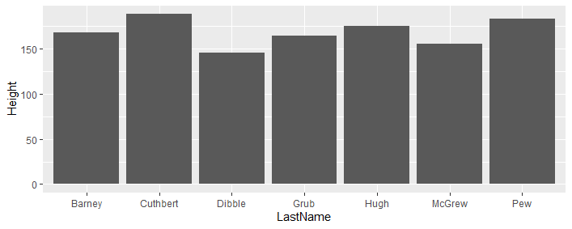
Reordering example Keep the original order
LastName FirstName Age Weight Height
<chr> <chr> <dbl> <dbl> <dbl>
1 Hugh Chris 26 90 175
2 Pew Adam 32 102 183
3 Barney Daniel 18 88 168
4 McGrew Chris 48 97 155
5 Cuthbert Carl 28 91 188
6 Dibble Liam 35 94 145
7 Grub Doug 31 89 164
trumpton %>%
ggplot(aes(x=LastName, y=Height)) +
geom_col()
The default is to order alphabetically

Slide 51
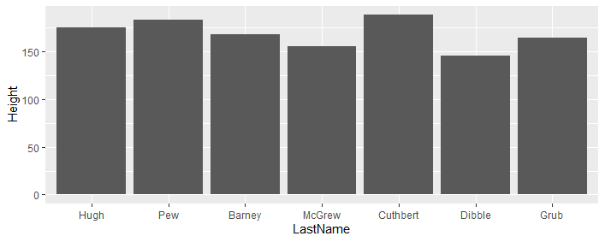
Reordering example Keep the original order
LastName FirstName Age Weight Height
<chr> <chr> <dbl> <dbl> <dbl>
1 Hugh Chris 26 90 175
2 Pew Adam 32 102 183
3 Barney Daniel 18 88 168
4 McGrew Chris 48 97 155
5 Cuthbert Carl 28 91 188
6 Dibble Liam 35 94 145
7 Grub Doug 31 89 164
trumpton %>%
mutate(LastName=factor(LastName, levels=LastName)) %>%
ggplot(aes(x=LastName, y=Height)) +
geom_col()
We can convert to a factor and use levels to enforce the same order. If we had just converted to a factor it would have been alphabetical still.

Slide 52
Quantitative ordering with reorder
The reorder function allows you to order the levels of a factor by a different quantitative variable
It allows you to sort a figure by value
reorder(categorical, quantitative)

Slide 53
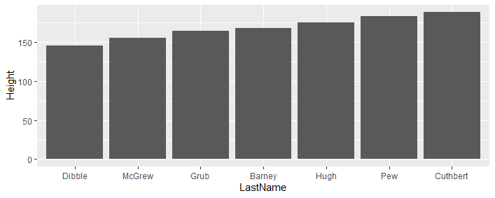
Reordering examples
LastName FirstName Age Weight Height
<chr> <chr> <dbl> <dbl> <dbl>
1 Hugh Chris 26 90 175
2 Pew Adam 32 102 183
3 Barney Daniel 18 88 168
4 McGrew Chris 48 97 155
5 Cuthbert Carl 28 91 188
6 Dibble Liam 35 94 145
7 Grub Doug 31 89 164
trumpton %>%
mutate(LastName=reorder(LastName,Height)) %>%
ggplot(aes(x=LastName, y=Height)) +
geom_col()
By using reorder we can make the levels correspond to a quantitative variable. Here it is the same one we're plotting, but it doesn't have to be.

Slide 54
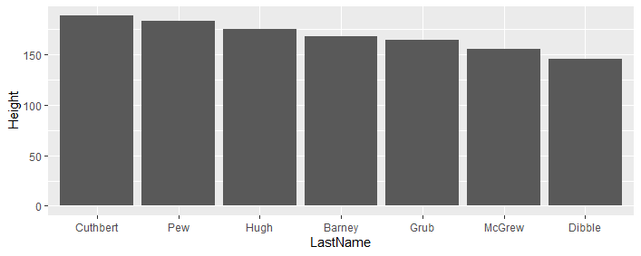
Reordering examples
LastName FirstName Age Weight Height
<chr> <chr> <dbl> <dbl> <dbl>
1 Hugh Chris 26 90 175
2 Pew Adam 32 102 183
3 Barney Daniel 18 88 168
4 McGrew Chris 48 97 155
5 Cuthbert Carl 28 91 188
6 Dibble Liam 35 94 145
7 Grub Doug 31 89 164
trumpton %>%
mutate(LastName=reorder(LastName,-Height)) %>%
ggplot(aes(x=LastName, y=Height)) +
geom_col()
We can use -Height in the reorder to reverse the sorting order

Slide 55
Exercise 3

Slide 56
Statistical Overlays

Slide 57
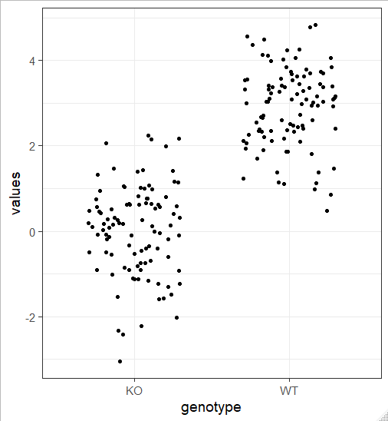
Overlaying raw data and summaries
many.values %>%
group_by(genotype) %>%
sample_n(100) %>%
ggplot(aes(x=genotype, y=values)) +
geom_jitter(height=0, width = 0.3)

Slide 58
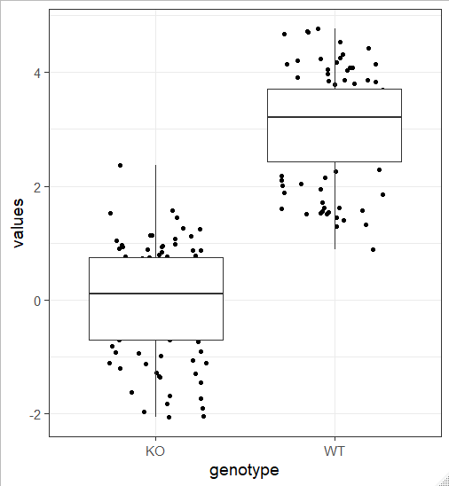
Overlaying raw data and summaries
many.values %>%
group_by(genotype) %>%
sample_n(100) %>%
ggplot(aes(x=genotype, y=values)) +
geom_jitter(height=0, width = 0.3) +
geom_boxplot()

Slide 59
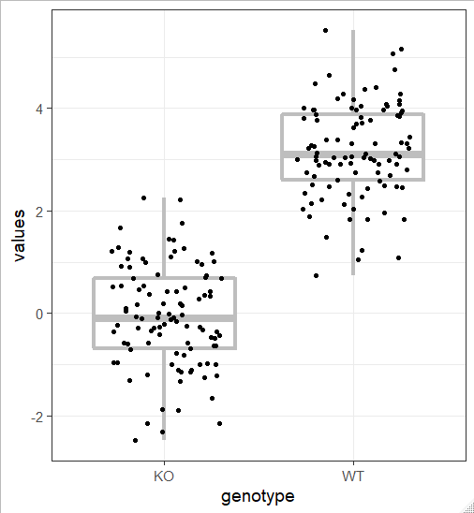
Overlaying raw data and summaries
many.values %>%
group_by(genotype) %>%
sample_n(100) %>%
ggplot(aes(x=genotype, y=values)) +
geom_boxplot(size=1.5, colour="grey") +
geom_jitter(height=0, width = 0.3)

Slide 60
Stat Summary
Add summary statistics to discrete data
Main options
geom – how is this going to be displayed
pointrange (default)
errorbar
linerange
Crossbar
fun.data
Function to produce
Min, Centre, Max
Eg mean_se, mean_cl_boot, mean_cl_normal,mean_sdl
Can also use fun.min, fun, fun.max separately

Slide 61
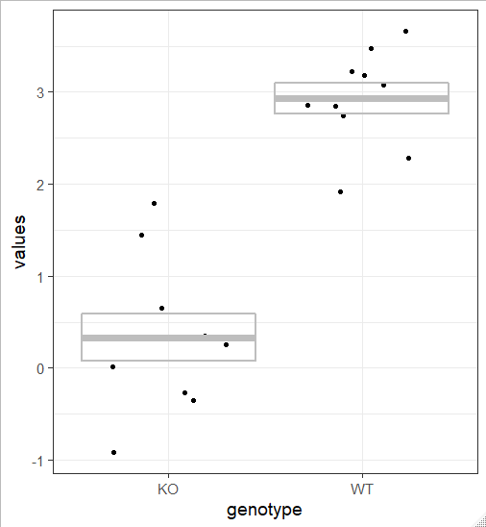
Overlaying raw data and summaries
many.values %>%
group_by(genotype) %>%
sample_n(10) %>%
ggplot(aes(x=genotype, y=values)) +
geom_jitter(height=0, width = 0.3) +
stat_summary(
geom="crossbar",
fun.data=mean_se,
size=1, alpha=0, colour="grey"
)

Slide 62
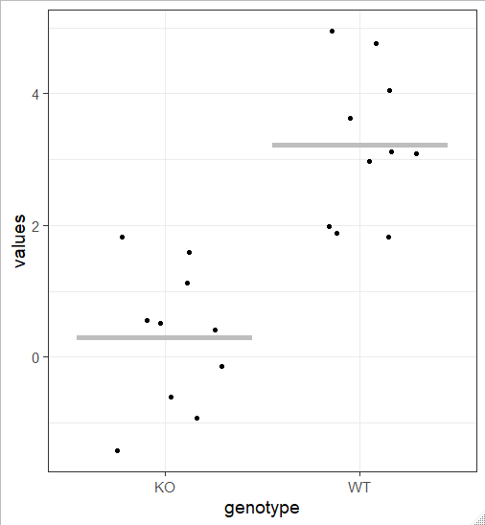
Overlaying raw data and summaries
many.values %>%
group_by(genotype) %>%
sample_n(10) %>%
ggplot(aes(x=genotype, y=values)) +
geom_jitter(height=0, width = 0.3) +
stat_summary(
geom="errorbar",
fun = mean,
fun.max = mean,
fun.min = mean,
size=2,
colour="grey"
)

Slide 63
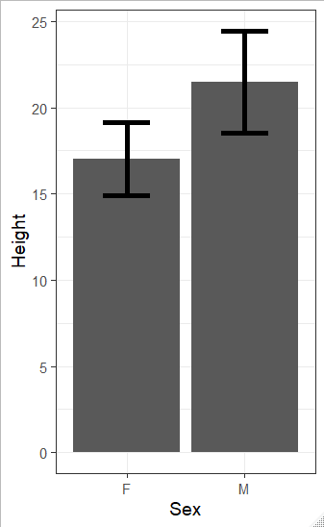
Overlaying raw data and summaries
group.data %>%
ggplot(aes(x=Sex, y=Height)) +
geom_bar(stat="summary", fun=mean) +
stat_summary(geom="errorbar", width=0.4, size=2)
NB The fun=mean in geom_bar is optional since that’s the default

Slide 64
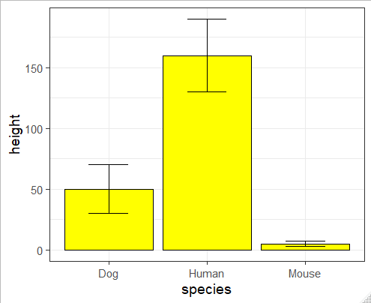
Using pre-calculated variance measures
data.with.stdev %>%
ggplot(aes(x=species,y=height, ymin=height-stdev, ymax=height+stdev)) +
geom_col(fill="yellow", color="black") +
geom_errorbar(width=0.4)
> data.with.stdev
# A tibble: 3 x 3
species height stdev
<chr> <dbl> <dbl>
1 Human 160 30
2 Dog 50 20
3 Mouse 5 2

Slide 65
Adding Reference / Regression Lines
geom_hline – Adds a horizontal line (specify yintercept)
geom_vline – Adds a vertical line (specify xintercept)
geom_abline – Adds an angled line (specify slope and intercept)
Values can come from the lm function to generate a linear model
geom_smooth – Calculates and draws regression lines
Loess smoothed curves
Linear modelled lines

Slide 66


Trend lines
trend_data %>%
ggplot(aes(x=trend,y=noise+trend)) +
geom_point() +
geom_hline(
yintercept=5, size=1, colour="red2") +
geom_smooth(size=1.5)
trend_data %>%
ggplot(aes(x=trend,y=noise+trend)) +
geom_point() +
geom_hline(
yintercept=5, size=1, colour="red2") +
geom_smooth(size=1.5, method="lm")

Slide 67
Exercise 4

Slide 68
Faceting and Highlighting

Slide 69
Faceting
Faceting allows you to take a single graph definition and create multiple graphs of the same type based on additional categorical factors
facet_grid draws graphs in rows and columns based on 1 or 2 factors
facet_wrap draws a 2D arrangement of graphs based on a single factor

Slide 70

Faceting – using facet_wrap()
child.variants %>%
ggplot(aes(x=MutantReadPercent, fill=CHR)) +
geom_density()

Slide 71


Faceting – using facet_wrap()
child.variants %>%
ggplot(aes(x=MutantReadPercent)) +
geom_density(fill="red2") +
facet_wrap(vars(CHR))
Note that the variable defining the facets must be passed through the vars() function

Slide 72

Faceting – using facet_grid()
group.data %>%
ggplot(aes(x=Height, y=Length)) +
geom_point(size=6, color="red2") +
facet_grid(
rows=vars(Genotype),
cols=vars(Sex)
)
Note that the variable defining the facets must be passed through the vars() function

Slide 73
Selective Overlays and Highlighting

Slide 74

Selective highlighting
# A tibble: 87 x 4
name height mass homeworld
<chr> <int> <dbl> <chr>
1 Luke Skywalker 172 77 Tatooine
2 C-3PO 167 75 Tatooine
3 R2-D2 96 32 Naboo
4 Darth Vader 202 136 Tatooine
starwars %>%
ggplot(aes(x=height,y=log(mass), label=name))+
geom_point() +
geom_text(vjust=1.5)

Slide 75
Selective highlighting
> famous
[1] "Yoda" "Darth Vader" "Chewbacca" "Han Solo" "R2-D2" "Luke Skywalker" "Leia Organa"
starwars %>%
filter(name %in% famous) -> starwars.famous
starwars %>%
ggplot(aes(x=height,y=log(mass),label=name))+
geom_point(col="lightgrey") +
geom_text(data=starwars.famous)+
geom_point(data=starwars.famous, color="red2")

Slide 76

Selective highlighting

Slide 77

Selective highlighting - ggrepel
library(ggrepel)
starwars %>%
ggplot(aes(x=height,y=log(mass),label=name))+
geom_point(col="lightgrey") +
geom_text_repel(data=starwars.famous)+
geom_point(data=starwars.famous, color="red2")

Slide 78
Annotation
The annotate function allows you to add geometries with data not coming from the original tibble
An easy way to put small additions (usually text) on your plot
Aesthetic mappings are set by arguments to annotate
Values can be multi-element vectors (unlike fixed aesthetics)
Use the geom argument to say which geometry to use

Slide 79

Annotation
data %>%
ggplot(aes(x=x,y=y)) +
geom_point() +
geom_abline(slope = 3, intercept=0, size=2, colour="grey") +
annotate(geom="text",x=350,y=280,label="R^2=0.96", size=10)

Slide 80

Saving plots
Operates on the last drawn plot by default
ggsave(
filename = "test.svg",
device = "svg",
width = 6,
height = 6
)

Slide 81

Saving complex plots
library(ggrastr)
up_down %>%
ggplot(aes(x=Condition1,y=Condition2)) +
rasterise(
geom_point(color=up_down$colour, size=0.7),
dpi=150
) -> mixplot
ggsave("mixplot.svg", plot=mixplot, device="svg", width=6, height=6)

Slide 82
Exercise 5

